Slide 1
Introduction to Wix
Taught By: Emily Sullivan and Claire Lavarreda
ENGW3307: Advanced Writing in the Sciences
Dr. Philip Gilreath
Fall 2023

Slide 2

Workshop Agenda
Understand some general best practices in website building.
Understand the strengths of Wix as a website building tool.
Learn how to create a website with Wix.
Slides available at: http://bit.ly/fa23-gilreath-engw3307-wix

Slide 3
Questions to Consider:
What kinds of websites do you usually see/engage with?
What are the advantages of creating websites in contrast to using other platforms (e.g., Canva or Twine)?
How would you go about making your own personal website?
Notes:
Note: Emily will show her own creative portfolio she made through Wix as an example: https://emgs12199.wixsite.com/artisticportfolio

Slide 4
Website building vocabulary
Pages: these are the main areas of your website that your audience will be able to navigate in your site’s menu.
Domain: your domain name is the unique URL that leads to your website.
Design: the aesthetic choices for your website, including colors, font, and more.

Slide 5
Website development best practices
Always remember your audience and think about how you want to represent your identity and your work to that audience.
Use the “Preview” button to see how your site will appear to your audience.
More ≠ better! You want your website to be easy to navigate, informative, and appealing.
Pick a theme/format that is compatible with mobile phones.
Design choices should be based on the content you are communicating.
For maximum readability, use simple fonts and a high color contrast between text and background color. This is particularly important for accessibility.
Good Good Not so good Not so good
Notes:
Dialogue with students:
What are some best practices you’ve discovered either building a website or interacting with a website as a user?
What do you like most about the websites you frequent?
What bothers you?

Slide 6
Building for your audience
A website is just like a research report or an essay—it needs to clearly communicate its message or purpose to a specific audience.
Critical first steps in website design are to consider who your audience is, what they will need to be able to find and do on your site, and how they will move through the site.
Work out what your website needs. Don’t add media or components to a website that don’t contribute to the site’s message/purpose.

Slide 7
Planning your website
Audience (Message/Purpose)
Content (Posts, Bio, Images)
Navigability (Headers, Pages, Menus, Hyperlinks)
User Experience / Accessibility (Interactivity, Color scheme, Readability, Alt text)
Design (Color scheme, Font size, Typeface)
Media (Images, Embedded elements)
Other Functionalities (Widgets, Buttons, etc.)

Slide 8
Starting points: questions to consider
Who is this site for?
Why would your identified audience(s) visit your site?
How will they find what they need, and navigate around?

Slide 9
Starting points: more questions to consider
What is the purpose of this site?
How can you communicate this clearly in the site’s content and design?
Can everyone use your site effectively? Is it accessible on mobile devices, and to people with disabilities?
How can you make smart design choices to enhance the site’s look, navigability, interactivity, functionality and accessibility?

Slide 10
Discussion: Text to Website
What additional functions does a website have that could strengthen your argument?
How does this kind of interaction differ from Canva or Twine?
When thinking about design, how can your website reflect and/or improve your narrative structure?
Notes:
Since Gilreath’s class previously had a lesson by us on Canva, and Prof Gilreath has stated a desire to encourage his students to try other methods besides just infographics, this would be a good slide to ask: “What are the benefits of using a website to display/communicate information over, say, an infographic?”

Slide 11
Building your website in Wix

Slide 12
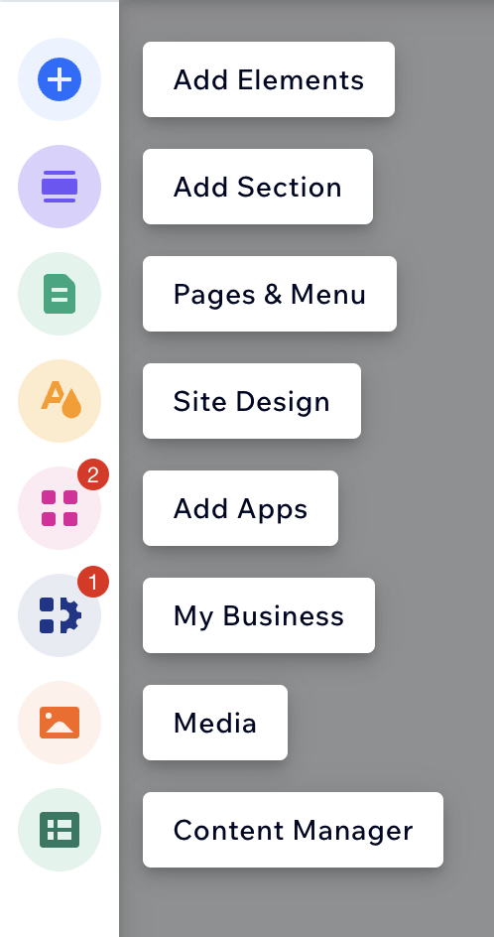
Wix vocabulary
Element: the basic unit of content for your site. Headings, paragraphs, media, buttons, lists, galleries etc. are elements.
Section: pages are divided into large chunks of content called “Sections.” They can be easily repositioned to change the layout of the page.
Pages & Menu: pages are collections of sections and the menu lets your user navigate between them. You might have a “Home” page, an “About Me” page, and a “Projects” page on your website.
Site Design: this is where you can apply themes to coordinate your website’s aesthetics across its pages.
Apps: these are Wix-specific widgets designed for businesses, including things like ordering platforms, live chats etc.

Slide 13

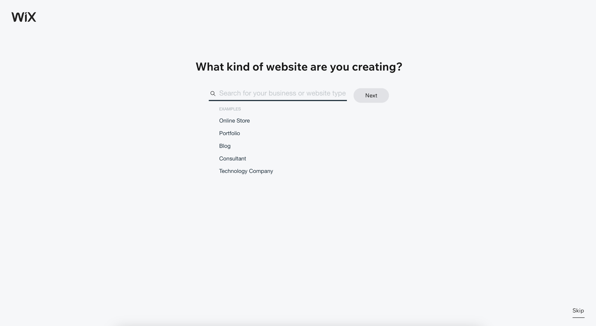
Getting started
Go to https://www.wix.com/ and click “Get Started.” Sign up for a Wix account using your professional email.
Click “Create New Site,” and then select what kind of site you want to create (e.g. “Portfolio”).
Give your site a name (this doesn’t need to be the domain name).
Notes:
Pop out to wix.com, “Create new site” then return to the slide deck

Slide 14
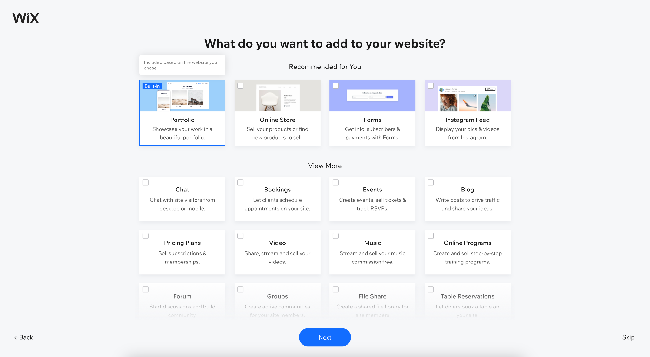
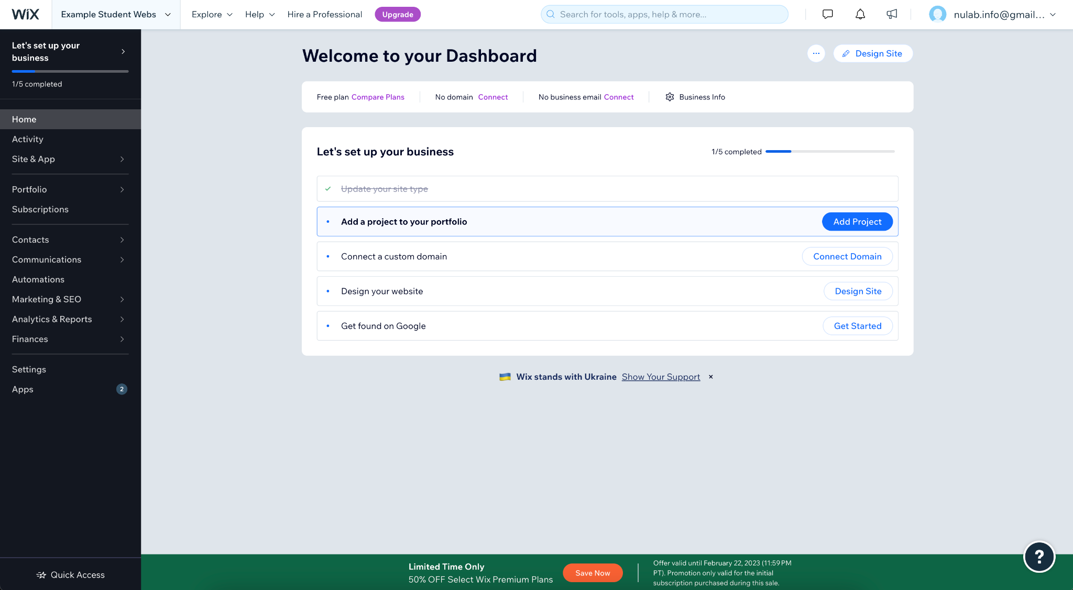
Getting started
Select any elements you want to include (e.g. “Online Store,” “Forms,” “Events”). You can edit these later.
Select “Go to Dashboard” to go to the back-end hub of your website.
From here you can design your website, connect a domain that you might own, and add type specific content (e.g. projects for a portfolio).
Notes:
Pop out to wix.com, “Create new site” then return to the slide deck

Slide 15
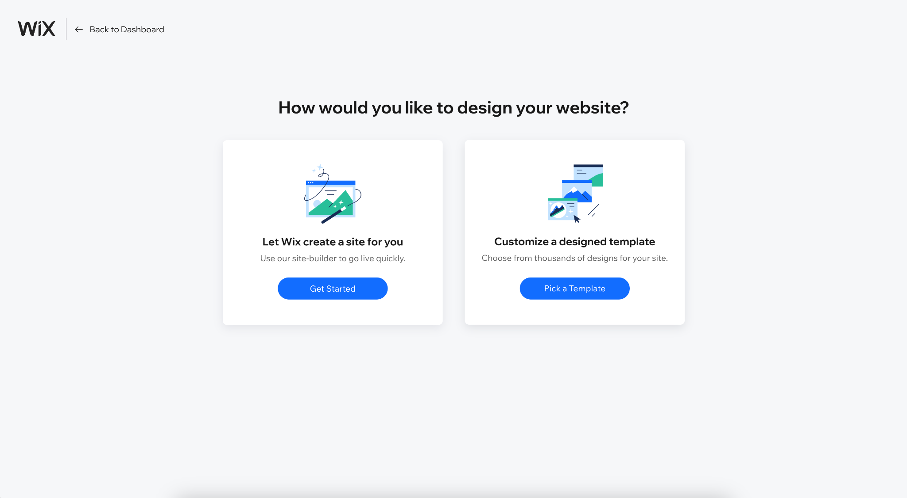
Designing your website
You will be asked to choose a starting point: letting the Wix ADI create a site for you, or customizing an existing template.
We recommend choosing a template, as you have more creative and operational control in the Wix Editor.
Notes:
Pop out to wix.com, “Create new site” then return to the slide deck

Slide 16
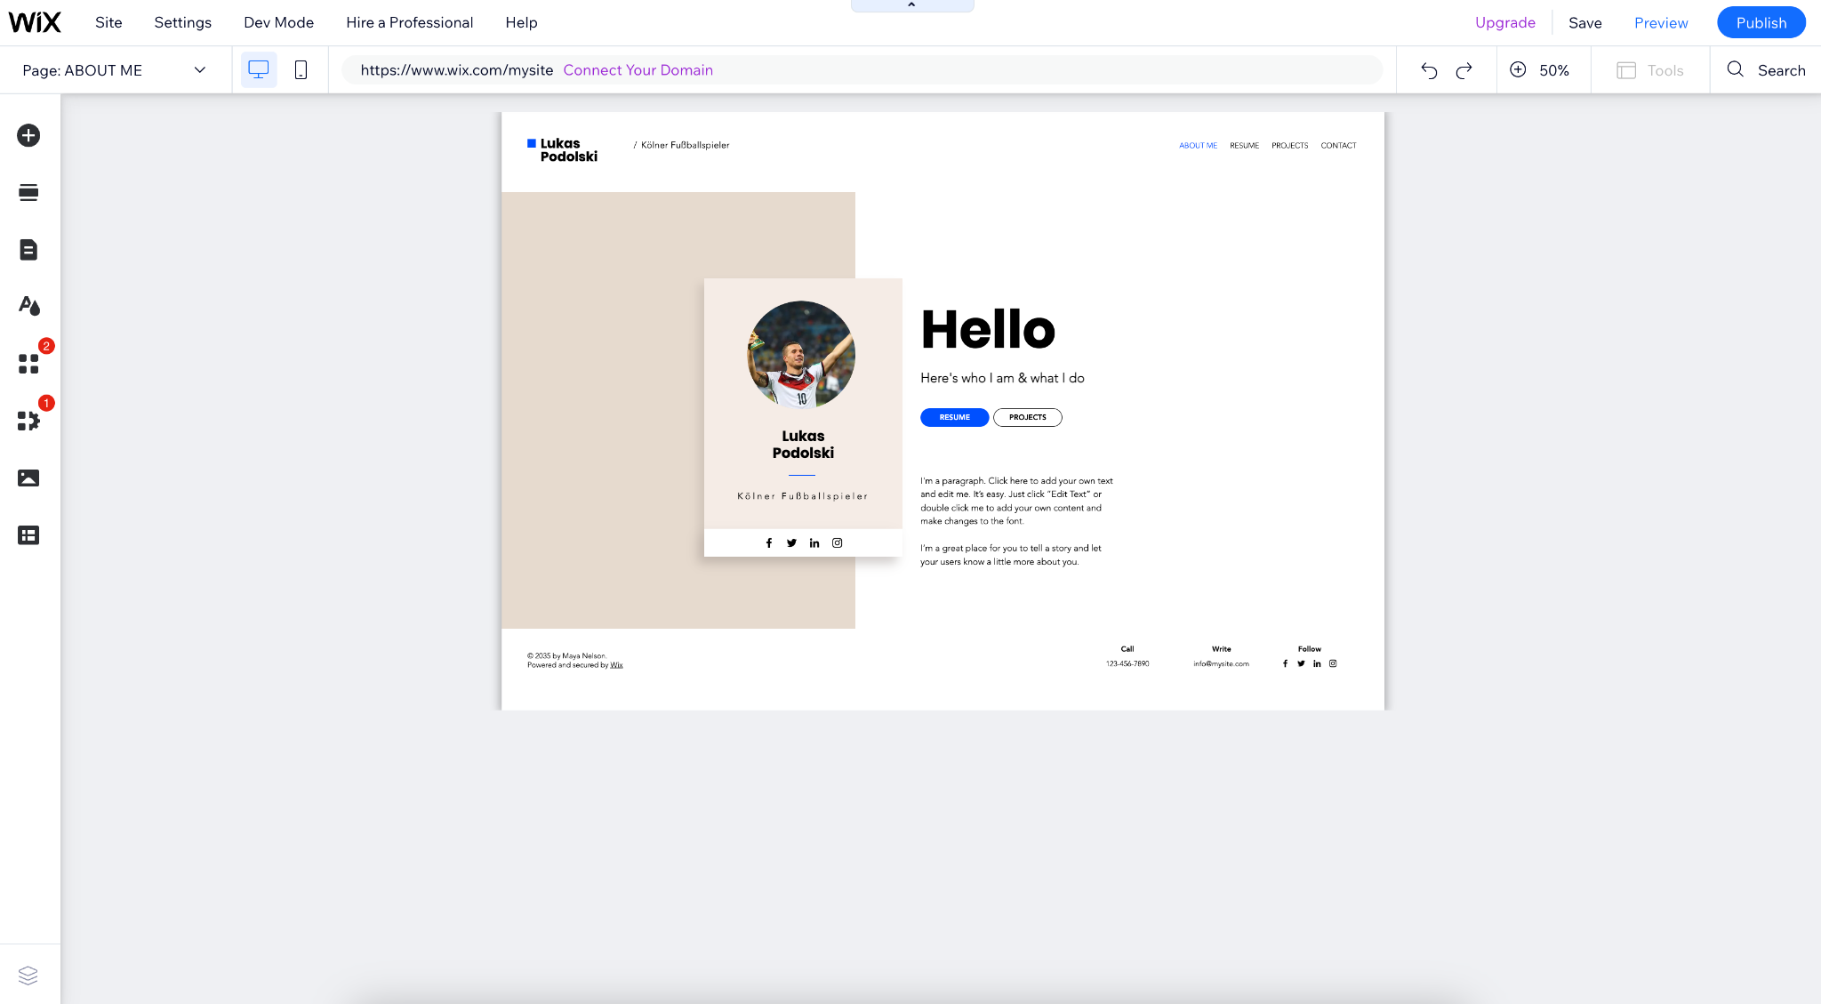
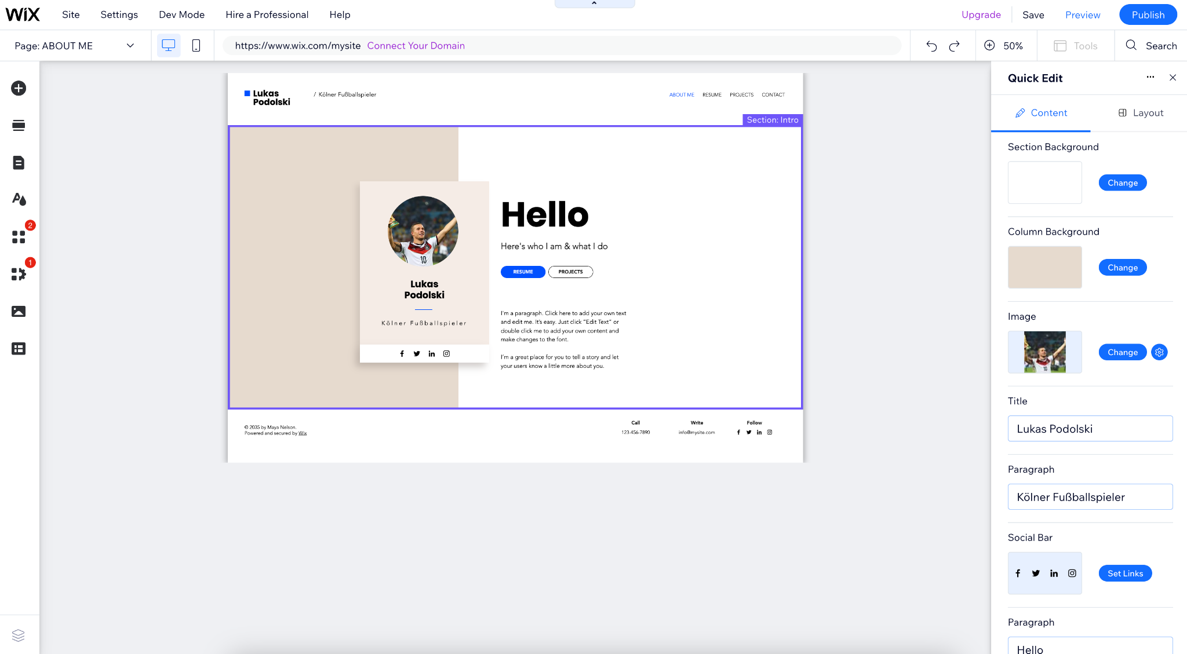
Wix Editor
Once you have chosen a template, the Wix Editor will open.
To add elements, sections, apps etc., use the panel on the left.
Hovering over any part of the page will allow you to open the “Quick Edit” panel, in which you can edit the content of the template.
Notes:
Pop out to wix.com, “Create new site” then return to the slide deck

Slide 17
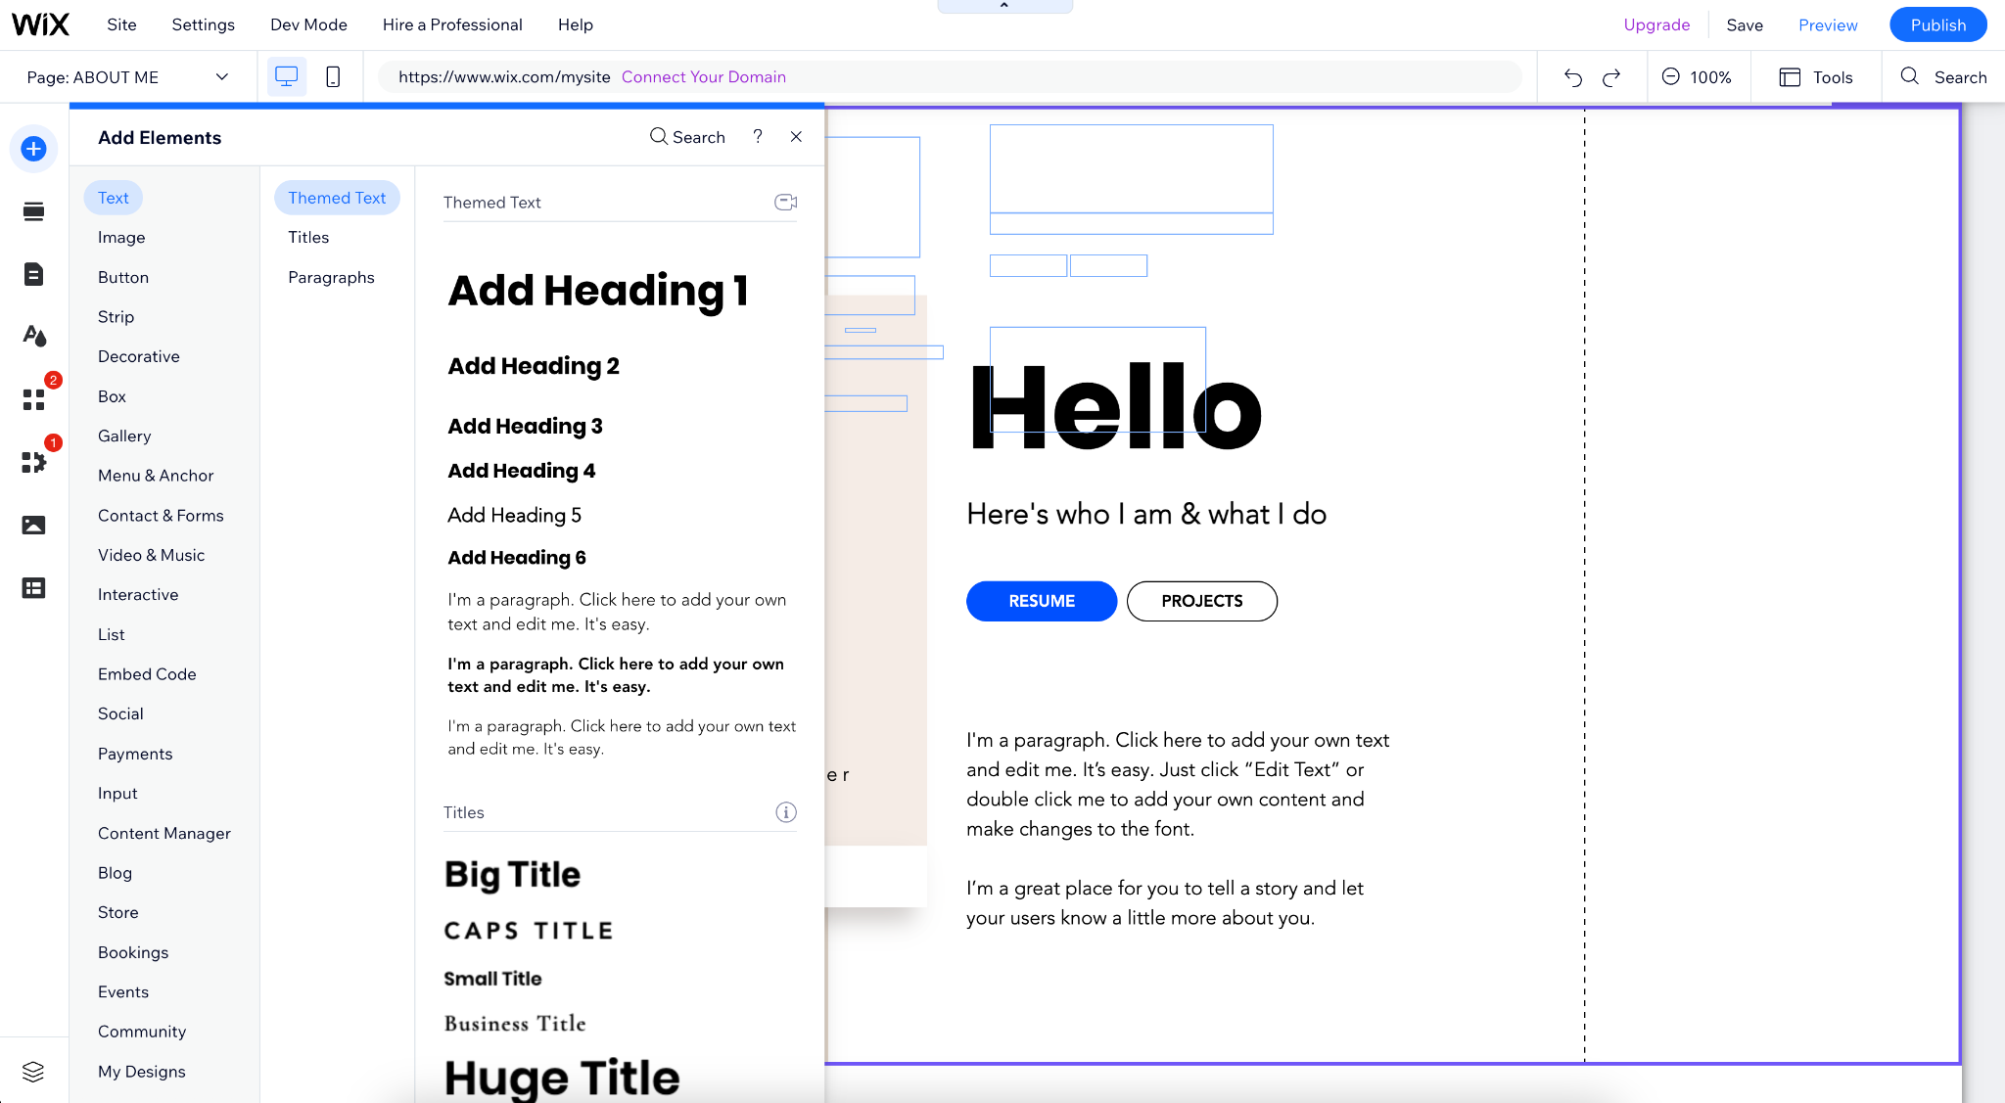

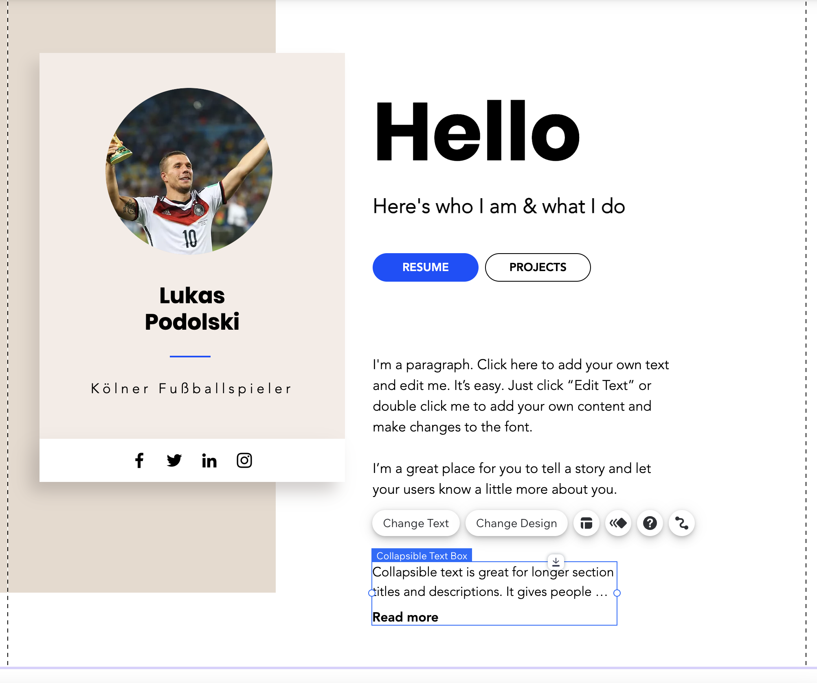
Adding Elements
To add Elements, click the top icon on the left panel.
This will open the Elements menu and you can choose from a huge variety of options.
Adding an element will float it in the center of your page, but you can drag it into position and edit it.
NB. To embed external media (like a StoryMap), add the “Embed” element from this menu.
Notes:
Pop out to wix.com, “Create new site” then return to the slide deck

Slide 18
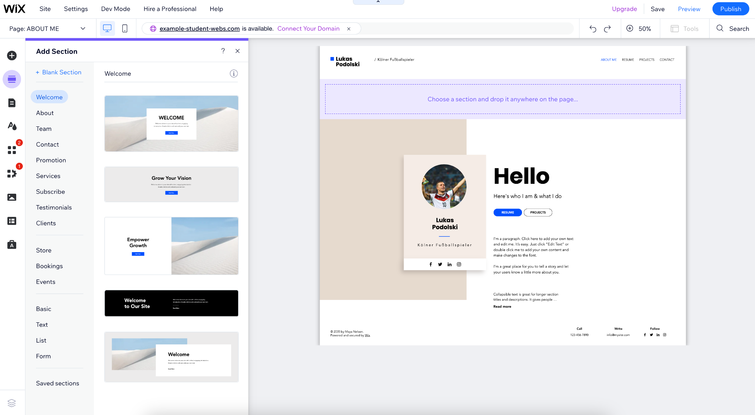

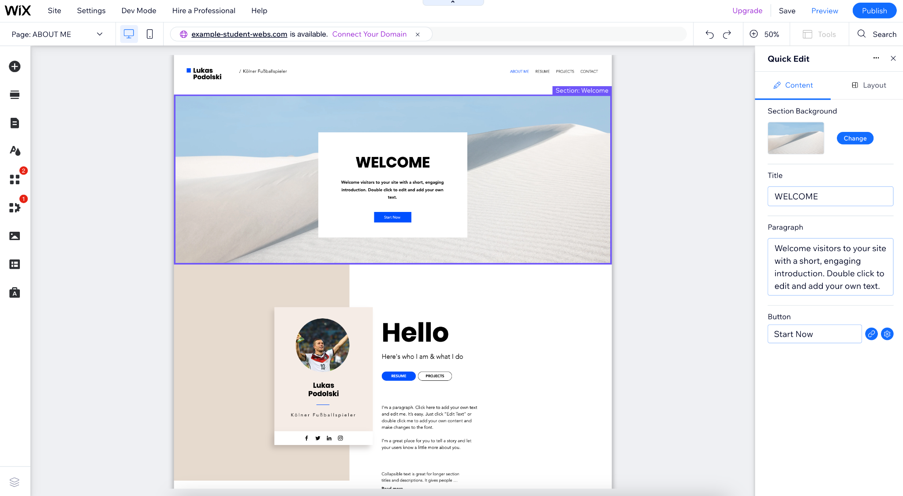
Adding Sections
Adding Sections works in the same way. Select the second icon on the left panel to open the menu.
You can choose from various sections, such as “Welcome,” “About Us/Me,” “List” and “Testimonials.”
Edit sections in the same way: hover over a section and open the “Quick Edit” panel or reposition it as desired.
Notes:
Pop out to wix.com, “Create new site” then return to the slide deck

Slide 19
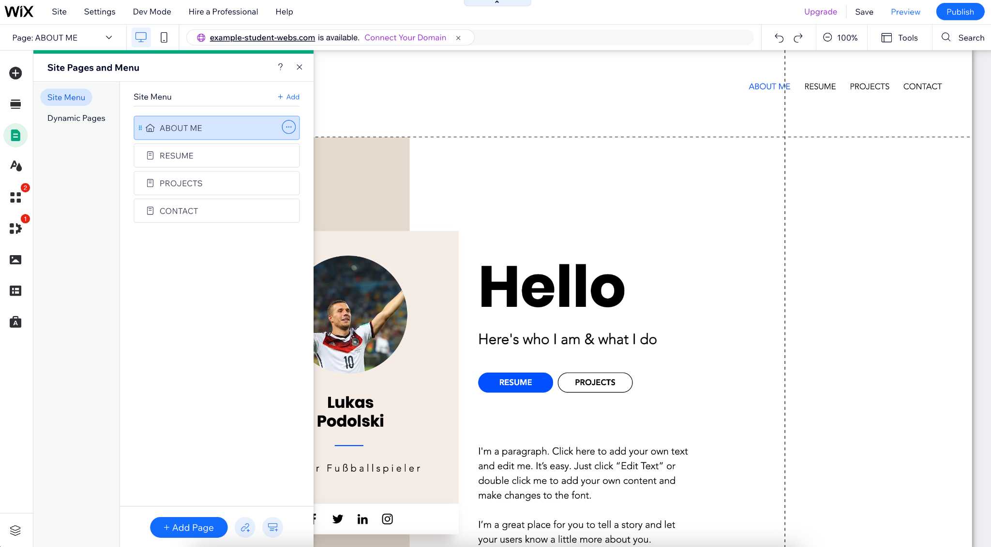

Adding Pages, editing the Menu
To add pages and edit the menu, select the third icon on the left panel to open the menu.
Your template will have a selection of pages, and you can navigate to them here.
Edit these pages in the same way using Elements and Sections.
Adding a new Page will automatically add it to the Menu.
Notes:
Pop out to wix.com, “Create new site” then return to the slide deck

Slide 20
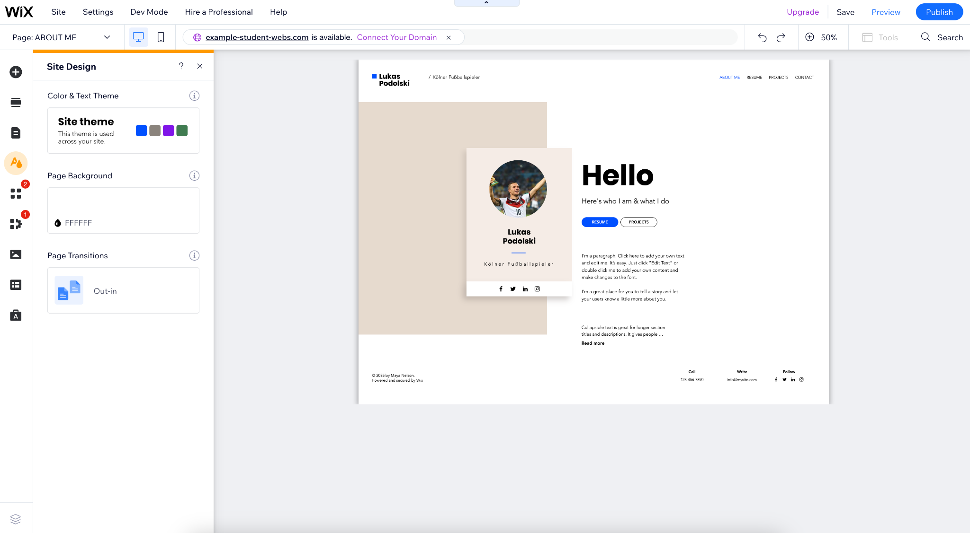

Site Design
Selecting the Site Design icon allows you to change the appearance of your website.
Editing the theme will change the color and text across your pages.
You can also customize the transitions between your pages.
Notes:
Pop out to wix.com, “Create new site” then return to the slide deck

Slide 21
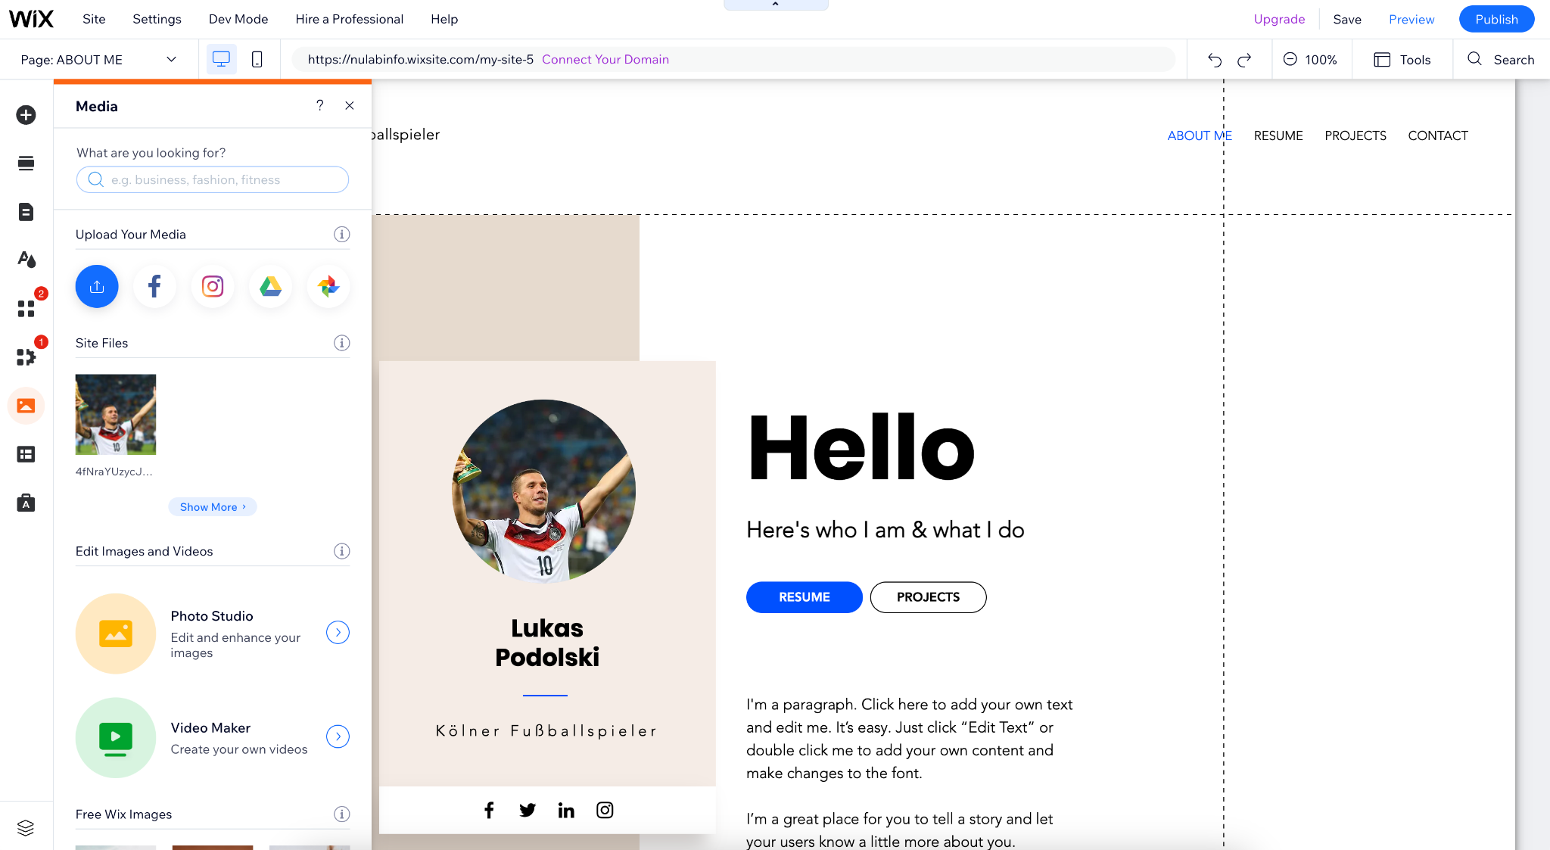

Adding Media
You can add media from the “Element” menu, but also by selecting the media icon.
You can select free images from Wix or Unsplash, upload files from your computer, link to URLs, or connect to social media.
You can drag and drop media within sections, and apply filters, effects, and otherwise edit it on the page.
Notes:
Pop out to wix.com, “Create new site” then return to the slide deck

Slide 22
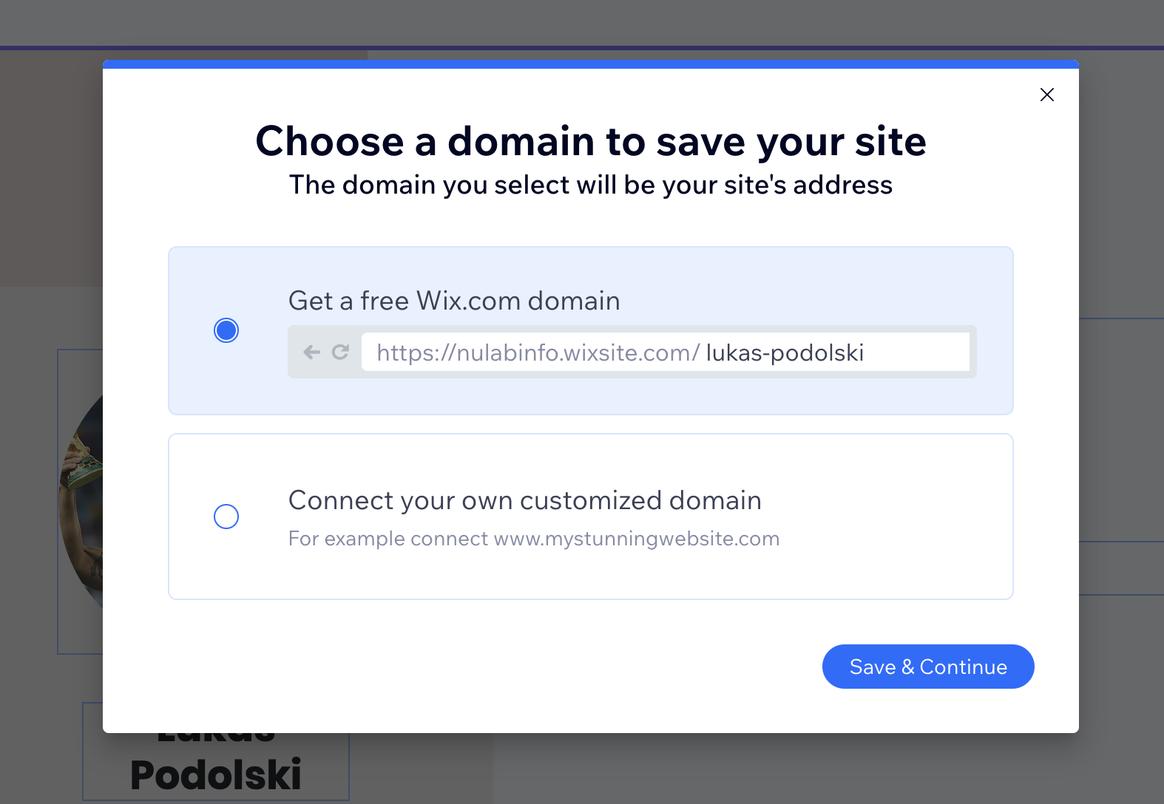
Publishing your website
Click “Save” from the top menu and select the domain name for your site. Free Wix sites will always have the “wixsite.com” suffix.
Preview your page, and, when you’re ready, click “Publish” in the top right to take your site live.
You can edit your website and monitor traffic from your dashboard.
Notes:
Pop out to wix.com, “Create new site” then return to the slide deck

Slide 23
Your Turn!
Notes:
Students will now work on/play around with Wix (aim for this by 8:30am)

Slide 24
Discussion Questions
What did you find worked really well while using Wix? What was difficult?
In what ways could you adapt your topic/content through a website?
How might a website help you better reach your audience?

Slide 25
Thank you!
—Developed by Kasya O’Connor Grant, Emily Sullivan, Ana Abraham, Chris McNulty, and Benjamin Grey
_ _ _ _ _
If you have any questions, contact us at nulab.info@gmail.com
Have questions? Schedule an appointment with us! https://calendly.com/diti-nu
Link to Online Materials: http://bit.ly/fa23-gilreath-engw3307-wix

